Slide 1
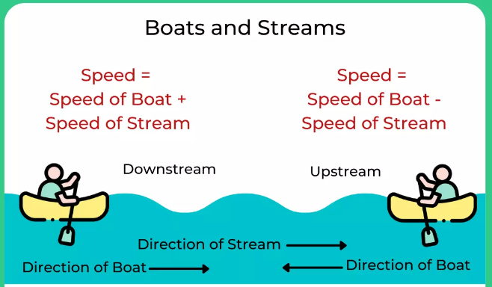

Slide 2
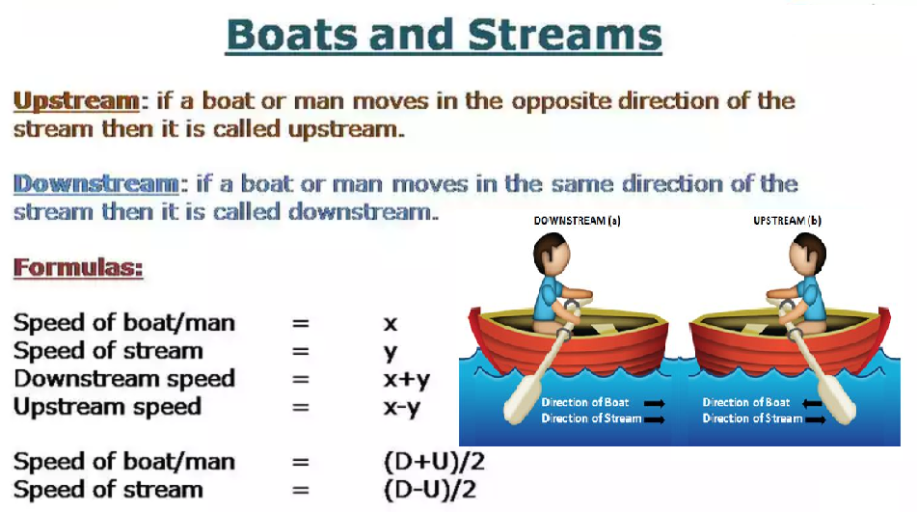

Slide 3
1. A man takes 20 minutes to row 12 km upstream which is a third more than the time he takes on his way downstream. What is his speed in still water?
41 km/hr
36 km/hr
42 km/hr
45 km/hr

Slide 4
2. How long will it take to row 20 km upstream if one can row 10 km in 10 minutes in still water and the same distance in 8 minutes with the stream?
12 min
13.33 min
24 min
26.67 min

Slide 5
3. A boat running downstream covers a distance of 16 km in 2 hours while for covering the same distance upstream, it takes 4 hours. What is the speed of the boat in still water?
4 km/hr
6 km/hr
8 km/hr
Data inadequate

Slide 6
4. A boat makes a return journey from point A to point B and back in 5 hours 36 minutes. One way it travels with the stream and on the return it travels against the stream. If the speed of the stream increases by 2 km/hr, the return journey takes 9 hours 20 minutes. What is the speed of the boat in still water? (The distance between A and B is 16 km.)
5 km/hr
3 km/hr
7 km/hr
9 km/hr

Slide 7
5.A boat travels from point A to B, a distance of 12 km. From A it travels 4 km downstream in 15 minutes and the remaining 8 km upstream to reach B. If the downstream speed is twice as high as the upstream speed, what is the average speed of the boat for the journey from A to B?
10(2/3)km/hr
9.6 km/hr
11.16 km/hr
10.44 km/hr

Slide 8
6. A man rows 24 km upstream in 6 hours and a distance of 35 km downstream in 7 hours. Then the speed of the man in still water is
4.5 km/hr
4 km/hr
5 km/hr
5.5 km/hr

Slide 9
7. There are 3 points P, Q and R in a straight line, such that point Q is equidistant from points P and R. A man can swim from point P to R downstream in 24 hours and from Q to P upstream in 16 hours. Find the ratio of speed of man in still water to speed of stream?
5 : 1
6 : 1
5 : 3
7 : 1
None of these

Slide 10
8. The ratio of the time taken by a boat to go a certain distance upstream and return downstream halfway of the same distance is 18 : 5. If the speed of stream is 4km/h what is the distance covered by the boat in 6 hours in downstream and 8 hours in upstream?
A. 192 km
B. 188 km
C. 208 km
D. 175 km
E. None of these

Slide 11
9. If the ratio of the speed of a boat in upstream and the speed of the stream is 8 : 1. If the boat can travel 500 km downstream in 20 hours then find the total distance travelled by the boat in still water in the same time?
A. 425 km
B. 459 km
C. 441 km
D. 450 km
E. None of these

Slide 12
10. The speed of current is 5 km/h. What will be the respective downstream speed and upstream speed of a boy rowing a boat, if one third of the distance covered going downstream in a certain time is equal to the distance covered going upstream in the same time.
15 kmph, 5 kmph
20 kmph, 10kmph
18 kmph, 8 kmph
24 kmph, 14 kmph
None of these

Slide 13
